Slide 1
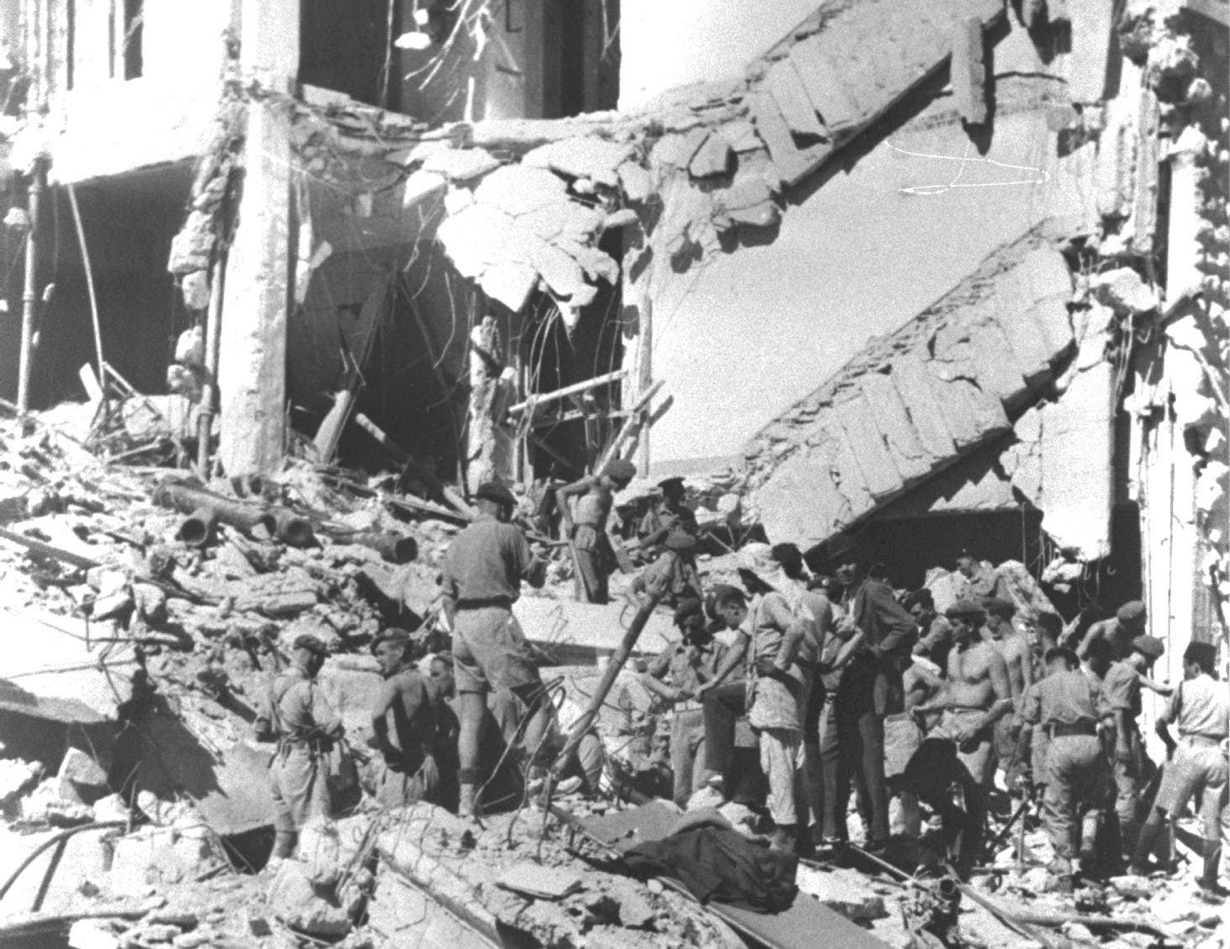
What were the consequences of WW2 for Mandate Palestine?
Lesson 6

Slide 2
Learning objectives
By the end of this lesson, you should be able to:
Describe the events of the late 1930s and early-mid 1940s in Mandate Palestine and Nazi Germany
Explain Britain’s wavering policies in Mandate Palestine at this time
Evaluate the effectiveness of British policy in Mandate Palestine during this period
What does ‘wavering’ mean?
To be undecided between two courses of action; to falter; to become weaker

Slide 3
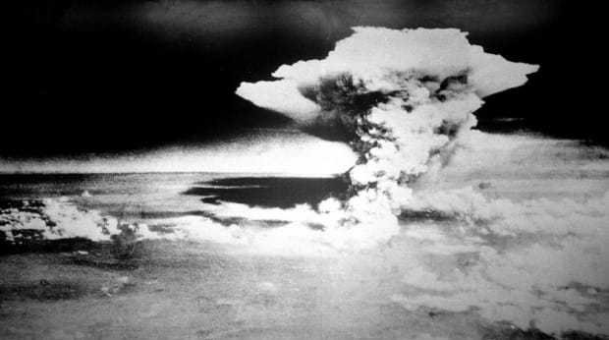
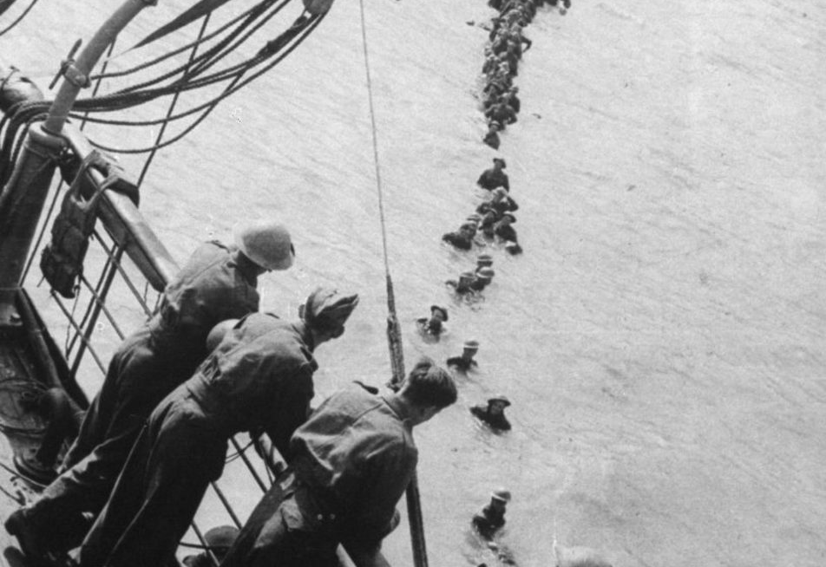
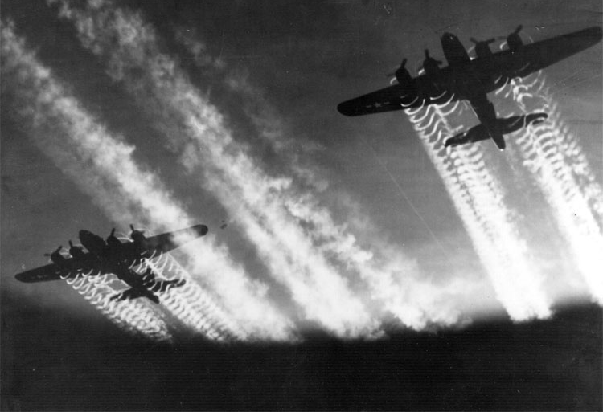
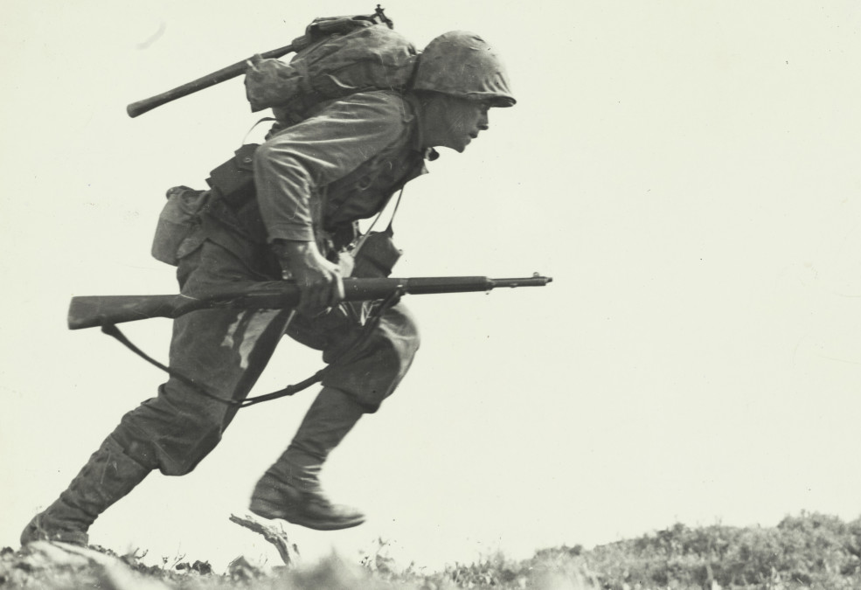
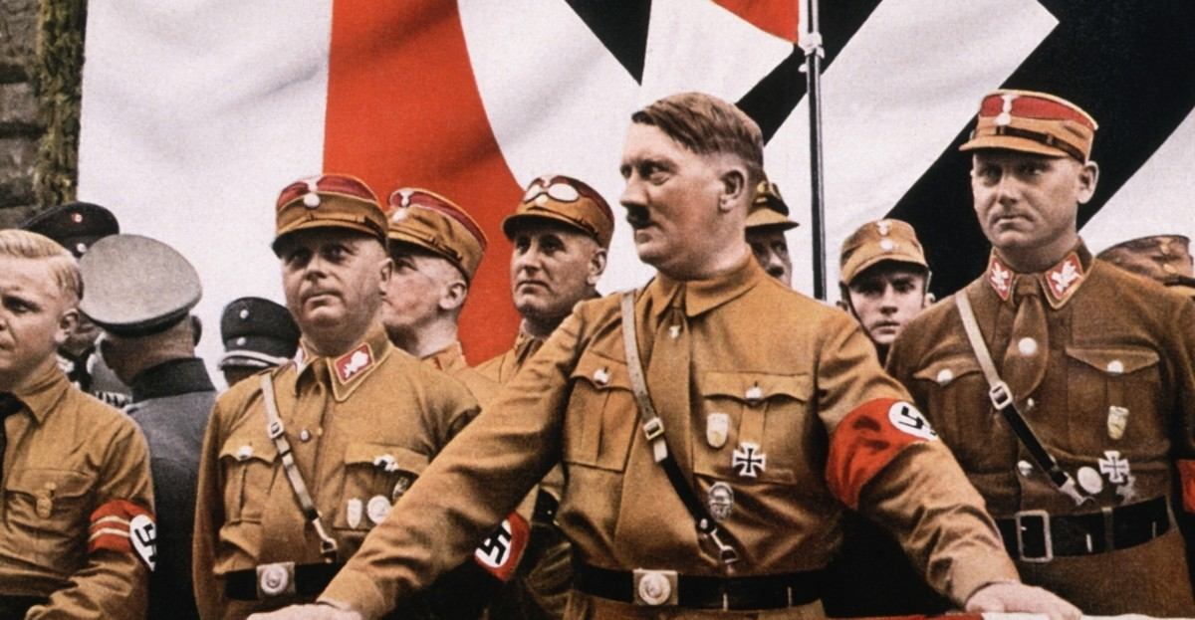
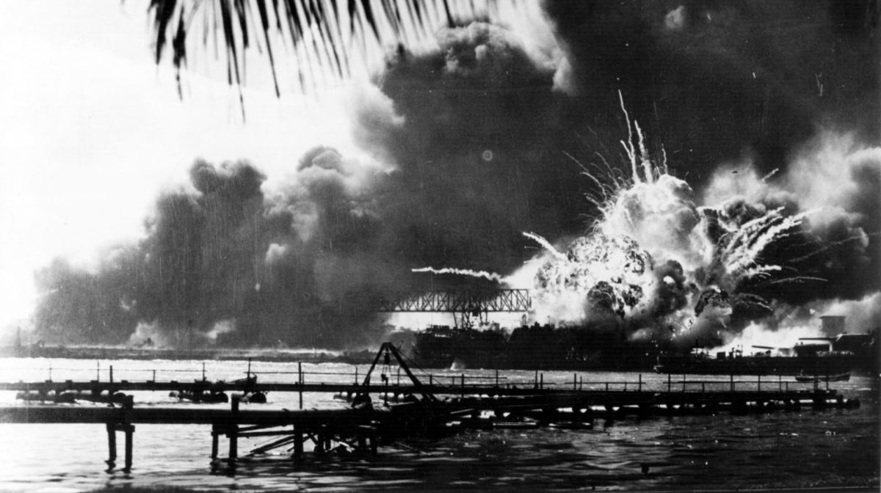
Starter activity
In small groups:
What do you already know about World War Two?

Slide 4
World War Two
Began when Germany, led by Adolf Hitler, invaded Poland in September 1939
France and Britain declared war on Germany because they didn’t think that what Germany was doing was right
Other countries became involved:
Main Axis countries: Germany, Italy and Japan
Main Allied countries: Britain, USA, France and the Soviet Union (Russia)
Ended in Europe on 8 May 1945. Carried on after this elsewhere. Officially ended for all when Japan surrendered on 2 September 1945
Many millions fought and died

Slide 5
Short clip on the consequences of WW2:
Watch 10.48-12.18

Slide 6
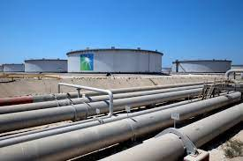
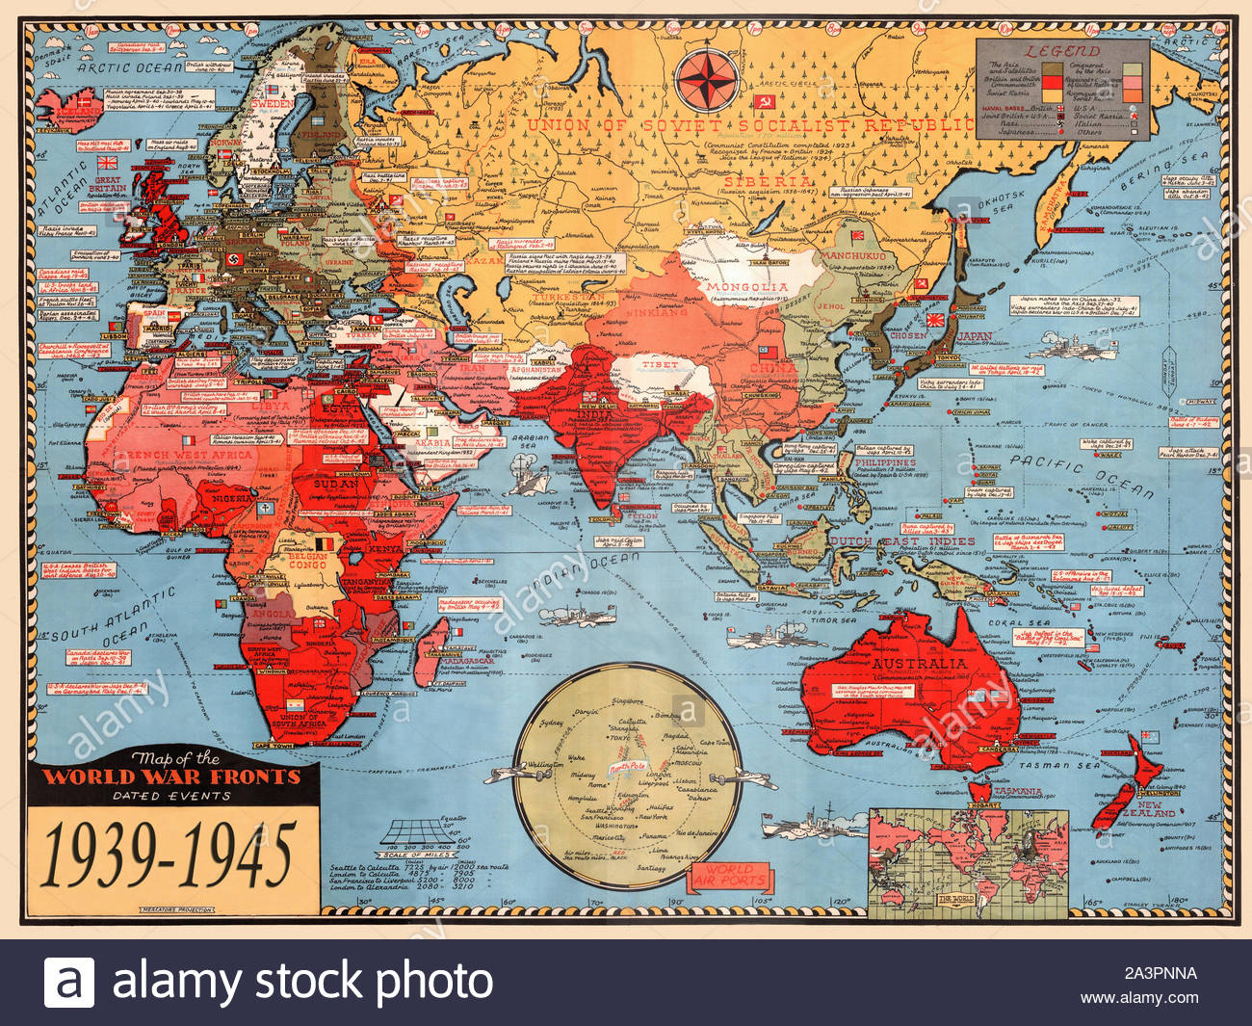
Can you guess today’s keywords from these images?
United Nations
Oil
World War Two
Can you define these terms?

Slide 7
Keywords: add these to your glossary
World War Two: a global war that lasted from 1939 until 1945
United Nations: an international organisation established after WW2 to replace the League of Nations and prevent another world war
Oil: a liquid derived from petroleum, especially for use as fuel. It is a fossil fuel and non-renewable
Irgun: a militant Zionist group in Mandate Palestine between 1931 and 1948

Slide 8
Keywords: add these to your glossary
The Holocaust (also known as the Shoah): the genocide of 6 million European Jews during WW2
Concentration camp: a place in which large numbers of people are deliberately imprisoned with inadequate facilities to provide forced labour or to await mass execution

Slide 9
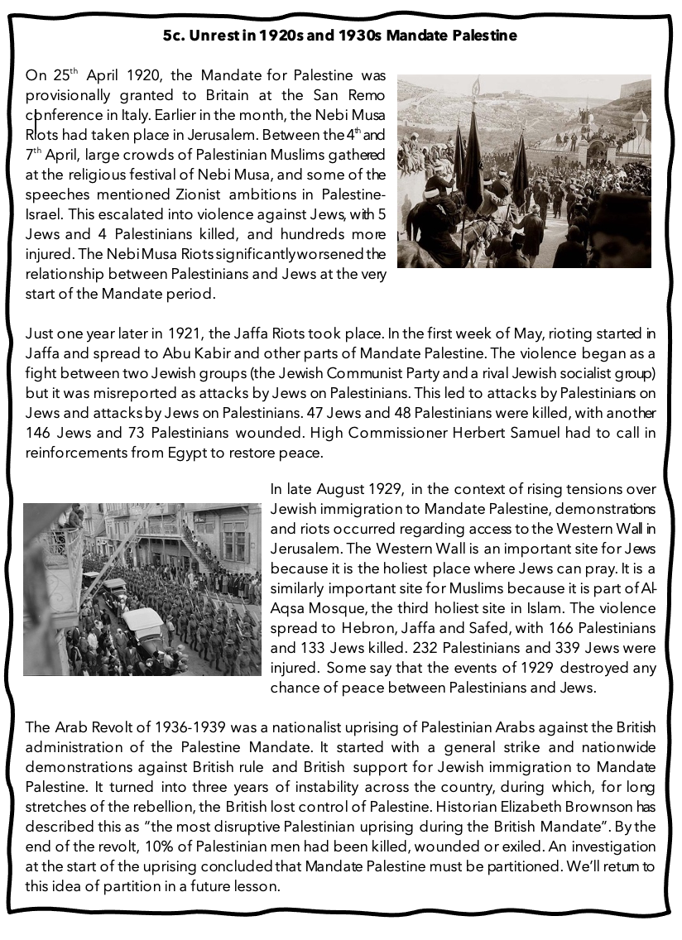
Recap
“The most disruptive Palestinian uprising during the British Mandate”
“By the end, 10% of Palestinian men had been killed, wounded or exiled”
What are these statements referring to?

Slide 10
The 1936-1939 Arab Revolt
Last lesson we saw that there was increasing tension between Palestinians and Jews in Mandate Palestine in the 1920s and 1930s, which often turned into violence. What other examples of violence can you remember? Your homework might be useful here
This came to a head with the 1936-1939 Arab Revolt, a large-scale nationalist uprising of Palestinian Arabs against the British administration. At the start of the revolt, it was considered that Britain might need to partition (split) Mandate Palestine into one Palestinian state and one Jewish state. But the Palestinians were not happy with partition as this would result in a further loss of their land

Slide 11
6a. If not partition, what should Britain do? Britain’s concerns in 1939
Britain needed to keep the Palestinians happy – it didn’t want another Arab Revolt, especially with another world war on the horizon. But what about Britain’s commitment to establishing a Jewish national home in Mandate Palestine? This was needed more than ever before with so many Jews fleeing persecution in Nazi Germany
Concern A: Britain needed to keep the Palestinians happy - it didn’t want a repeat of the Arab Revolt. The Arab Revolt had damaged buses, railways, oil pipelines and army posts in Mandate Palestine. The British had to deploy 20,000 soldiers to restore order (and unfortunately there were many incidents of brutality by British police and troops)
In small groups, read through Britain’s concerns and answer these questions in your books:
Why were concerns A, B and C important to the British in 1939?
Was one of these concerns more important than the others?
What should Britain do now? Address what Britain should do about Jewish immigration in your answer
Concern B: War was looking increasingly likely now. Stability in Mandate Palestine and the Middle East more broadly was vital for the British because this area was home to important communication and supply lines, and oil! These things would be even more important than usual in the event of a war, so Britain needed stability in Mandate Palestine and the Middle East
Concern C: Britain had promised to help with the establishment of a homeland for the Jews in Mandate Palestine. This promise had even been incorporated into the Mandate! This was now more important than ever, particularly in light of the way Jews were being treated in Nazi Germany

Slide 12
6b. The White Paper of 1939
In May 1939, a decision was finally reached and published by Neville Chamberlain (British Prime Minister) as the White Paper of 1939
Stick 6b. The White Paper of 1939 into your book and read through the key points
With the person sitting next to you, discuss:
What were the new limits on Jewish immigration to Mandate Palestine? How would this make you feel if you were Jewish?
What were the limits to Zionist land purchase? How would this make you feel if you were Palestinian?
Extension question: what is problematic about the final key point about the future of Palestine-Israel?
Reactions:
The Palestinian leadership officially rejected the White Paper, whilst some more moderate Palestinians were prepared to accept it
Zionist groups immediately rejected it and launched a campaign against it, but they recognised the need to work with the British when war broke out in September 1939:
"We will fight the White Paper as if there is no war, and fight the war as if there is no White Paper” David Ben-Gurion, head of the Jewish Agency in 1939

Slide 13
6c. Fill in the blanks using these words:
Middle East
two
White Paper
May
Neville Chamberlain
Western Wall
Nebi Musa
oil
75, 000
splitting
Nazi Germany
Jaffa
1920s and 1930s Mandate Palestine was characterised by instability: the _________ riots in April 1920, the _____ riots in ___ 1921, the ____________ riots which spread nationwide in 1929 and the Arab Revolt of 1936-1939.
By 1937, Britain was considering partition: the _______ of Palestine-Israel into __ countries. But this was rejected by the Palestinians and in the late 1930s, Britain was increasingly aware of the importance of maintaining stability in Palestine and the __________ more broadly. With a possible war on the horizon, Britain needed access to its key communication and supply routes and ___.
But Britain also needed to help the Jews who were fleeing ___________. In 1939, _____________ announced the _________. This limited Jewish immigration to _____ over 5 years and restricted Zionist land purchases too. Many members of the Jewish community felt that this was cruel.
Exchange your completed worksheet with the person sitting next to you

Slide 14
What do you know about the Holocaust?

Slide 15
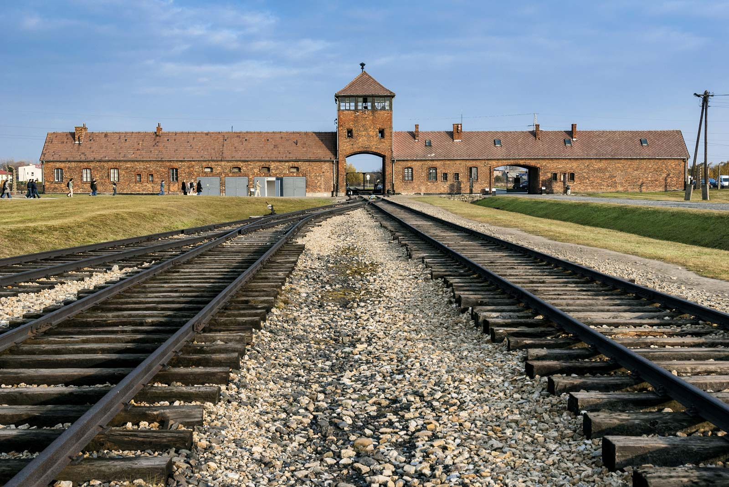
The Holocaust
From Lesson 2:
Also known as the Shoah, the Holocaust was the genocide of 6 million European Jews during WW2
It involved pogroms, mass shootings and murder through forced labour and gas chambers
The main concentration camps were Auschwitz-Birkenau, Belzec, Chelmno, Majdanek, Sobibor and Treblinka
The Nazis called the extermination of Jews the “Final Solution” to the “Jewish Question”
Two thirds of Europe’s Jewish population was murdered
Auschwitz-Birkenau

Slide 16
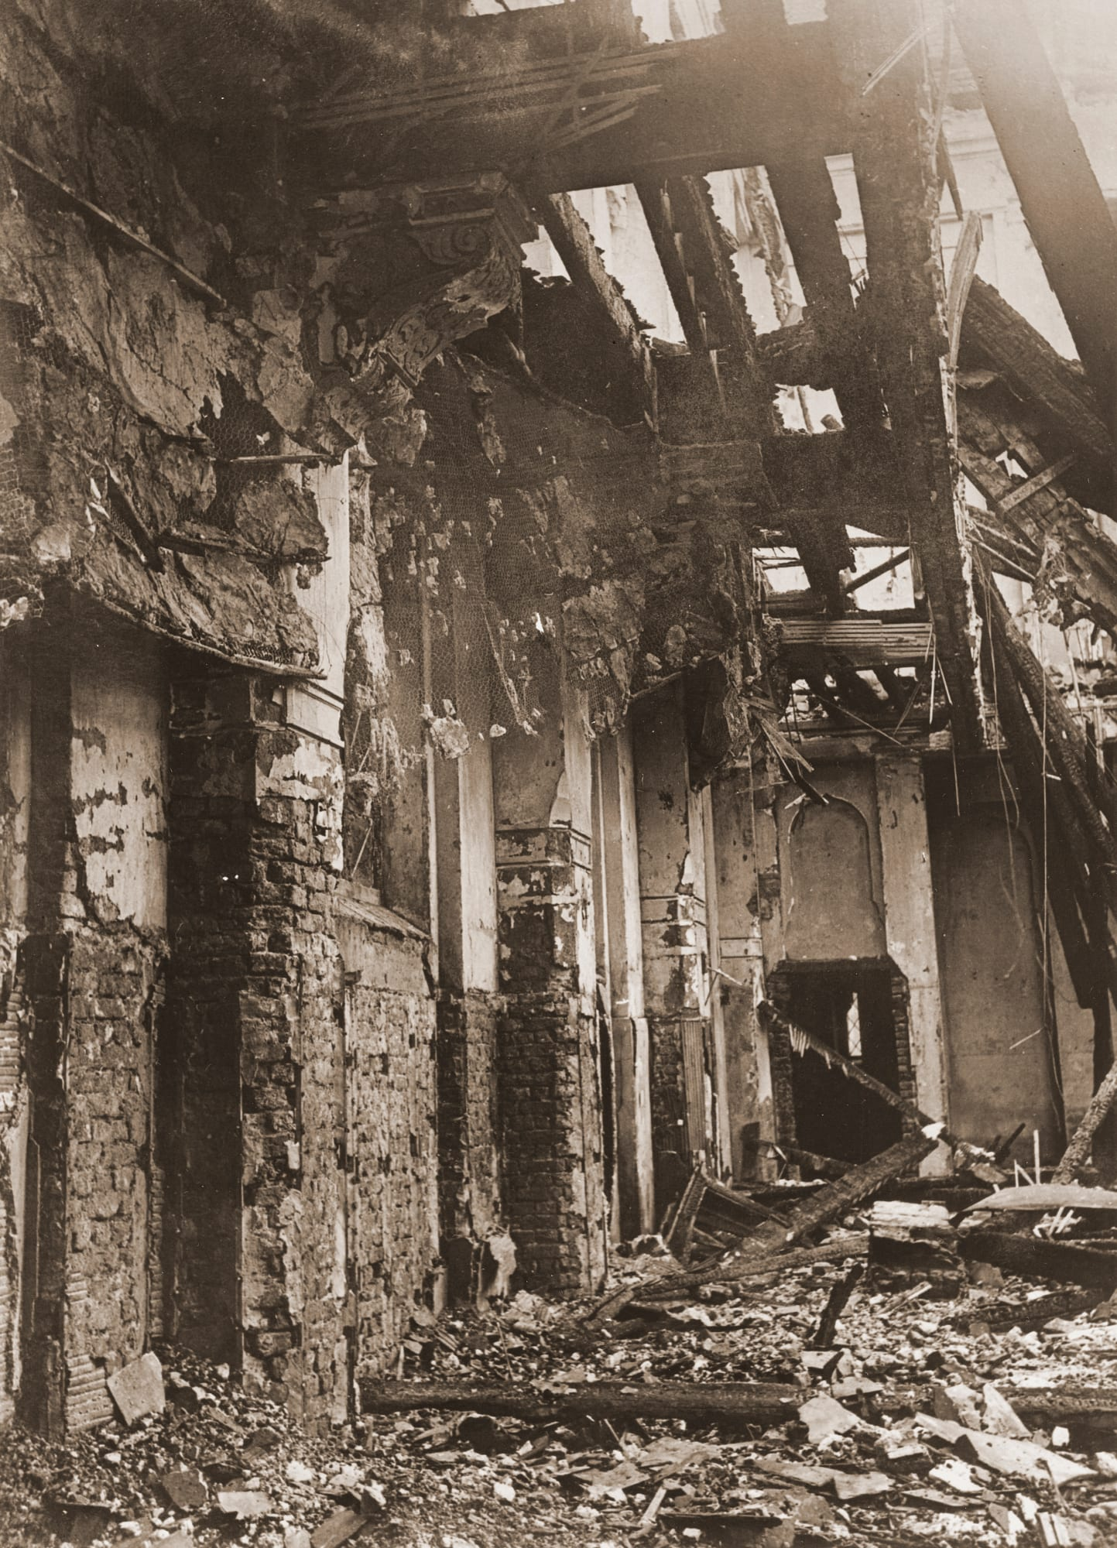
The persecution of Jews in Germany
The Holocaust is dated as 1941-1945, but the persecution of Jews in Germany began in the early 1930s
In 1933, concentration camps started to be built and Jewish businesses were boycotted
In 1935, the antisemitic Nuremberg Laws were passed
In November 1938, Jewish businesses and other buildings were attacked and set on fire throughout Germany and Austria (this was known as Kristallnacht, the “Night of Broken Glass”)
Photograph from Kristallnacht

Slide 17
6d) Building on your timeline of antisemitism in Europe from Lesson 2, create a brief timeline of the persecution of Jews in Germany from 1933 to 1945
Lesson 2:

Slide 18
Have you read Anne Frank’s diary?
https://www.yadvashem.org/education/educational-videos.html
Anne Frank’s diary went on to be the most famous, and best-selling personal diary of all time

Slide 19
To learn more about the Holocaust you can visit the website of Yad Vashem, the World Holocaust Remembrance Center: yadvashem.org

Slide 20
Meanwhile, in Mandate Palestine…
We saw earlier how the British government wavered in the late 1930s
The British were anxious to avoid a repeat of the Arab Revolt of 1936-1939 and needed stability in the Middle East during the war, but they also knew that Jews fleeing Nazi Germany needed a home
The White Paper of 1939 had restricted Jewish immigration to 75, 000 over 5 years
In 1945 Ernest Bevin, the British foreign secretary, increased the limit for Jewish immigration to 18, 000 a year
But many members of the Jewish community within Mandate Palestine and beyond still thought this was unfair

Slide 21
The Jewish response
Jewish opposition groups emerged in response to this policy
Two extremist groups emerged: the Irgun and the Lehi
They commenced a series of brutal attacks in Mandate Palestine. They attacked offices, police stations, radio stations and telephone lines
Two key examples of this violence:
The assassination of Lord Moyne, a British minister of state who was killed in Cairo on 6th November 1944 by the Lehi
The King David Hotel bombing on 22nd July 1946 - an attack carried out by the Irgun on the headquarters of the Mandate administration and the British army. 28 Brits, 41 Palestinians and 17 Jews were killed
The King David Hotel bombing

Slide 22
Britain asks for help
As the concentration camps were liberated at the end of the war and the full horrors of the Holocaust came to light, there were calls for an independent Jewish state
But the British were still worried about the Palestinians: the Palestinians had lived on this land for centuries and they had never received their promised independent state
Britain couldn’t afford a repeat of the Arab Revolt. It was war weary and financially destitute
As the attacks by the Irgun and the Lehi continued, Britain’s position became impossible and it reached a decision: in February 1947, it asked the United Nations for help
We’ll continue with this next lesson
In small groups, reflecting on today’s lesson, create a spider diagram with the reasons why Britain asked the UN for help in February 1947. Are any of these reasons linked?

Slide 23
Plenary
What were the consequences of WW2 for the following:
Jews in Germany
The British in Mandate Palestine
Jews in Mandate Palestine
Palestinians in Mandate Palestine

Slide 24
Homework Exam-style question
Explain two consequences of World War Two for Mandate Palestine.
Include these terms in your answer:
Oil
Holocaust
Irgun

